Slide 1
Mississippi’s Annual Affordable Housing Conference 2022
CHEERS TO 30 YEARS!
Beau Rivage Resort & Casino
Biloxi, MS
March 29-31

Slide 2
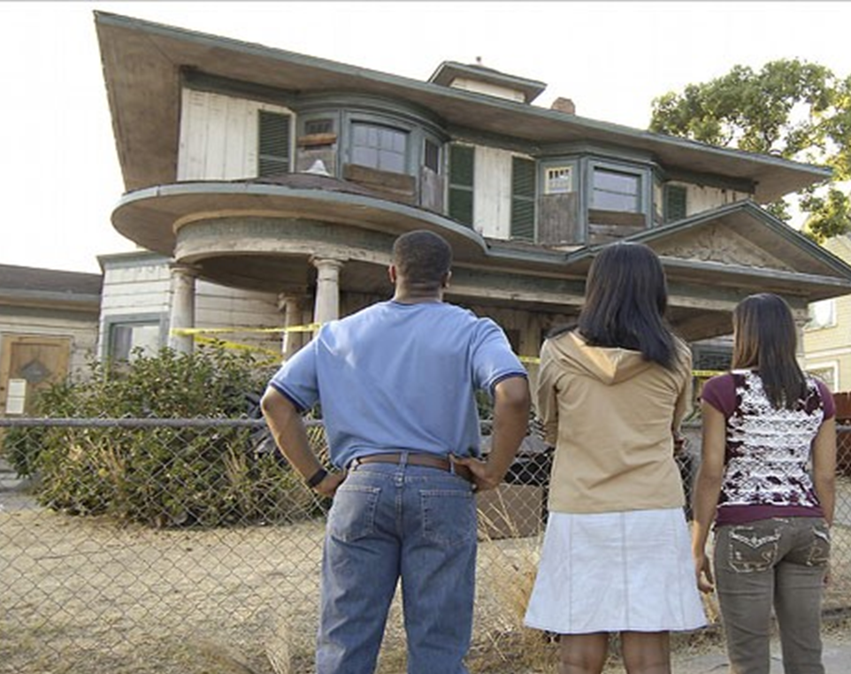
FAIR HOUSING: KNOW YOUR RIGHTS

Slide 3
The work that provided the basis for this publication was supported by funding under a grant with the U.S. Department of Housing and Urban Development. The substance and findings of the work are dedicated to the public. The author and publisher are solely responsible for the accuracy of the statements and interpretations contained in this publication. Such interpretations do not necessarily reflect the views of the Federal Government.

Slide 4
WHAT YOU WILL LEARN TODAY
What fair housing laws are
Who is protected
What properties are covered
What properties are exempt
How to file a complaint

Slide 5
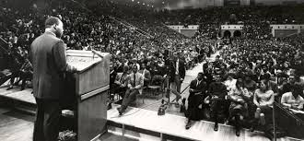
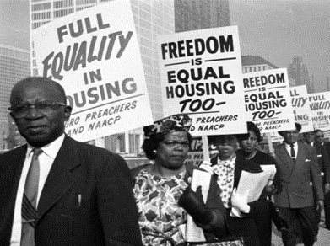
THE FEDERAL FAIR HOUSING ACT
Passed in 1968, after the assassination of Rev. Dr. Martin Luther King, Jr.
Significantly strengthened when it was amended in 1988

Slide 6
SEVEN PROTECTED CLASSES
Race
Disability
Family Status
National Origin
Sex
Religion
Color

Slide 7
TRANSACTIONS COVERED
Sales
Rentals
Insurance
Denial of Reasonable Accommodations
Denial of Reasonable Modifications
All Areas Connected with Residential Housing

Slide 8
HOUSING COVERED
Apartments, houseboats, homeless shelters, and migrant farmworker housing.
Any residential building or vacant land available for the sale or lease of a dwelling.
Any place to which a person “intends to return.”

Slide 9
ACTIONS THAT CAN VIOLATE THE LAW

Slide 10
REFUSE TO RENT OR NEGOTIATE
Failing to accept or consider a bonafide offer;
Refusing to sell or rent or negotiate for sale or rental;
Imposing different sale prices or rental charges;
Using different qualifications criteria or applications, standards, procedures; and
Evicting tenants because of race, etc...or because of the race of tenant’s guest.

Slide 11
DISCRIMINATE IN TERMS OR CONDITONS
Using different provisions in leases or contracts;
Failing or delaying maintenance or repairs;
Failing to process an offer or communicate an offer accurately; or
Limiting use of privileges, services, facilities of an owner, tenant or a person associated with him or her.

Slide 12
RENTALS AND SALES
Imposing different sale prices or rental charges;
Using different qualifications criteria or applications, standards, procedures;
Ignoring a call from a prospective renter because he or she has an accent;
Evicting tenants because of race, etc...or because of the race of tenant’s guest;
Failing or delaying maintenance or repairs; and
Limiting use of privileges, services, facilities of an owner, tenant or a person associated with him or her.
Placing an ad that says, “no children allowed.”

Slide 13
DISCOURAGING, STEERING OR SEGREGATING APPLICANTS
Communicating to prospective renter that he or she would not be comfortable or compatible with existing residents because of their race.
Refusing to take or show listings of dwellings in certain areas.
Assigning applicant to a particular section of a community, neighborhood or development or particular floor of a building.

Slide 14
Untruthful Information
Indicating through words or conduct that a unit which is available for inspection, sale or rental has been sold or rented because of race…
Limiting information by word or conduct regarding suitably priced dwellings available for inspection.
Manager only quotes highest priced apartments as available.

Slide 15
TREATMENT v. IMPACT
Differential treatment: Treating someone differently because of race, color, religion, sex, national origin, disability or because they have children.
For example, charging people of color a higher rent or deposit for the same unit rent or refusing to allow children access to the pool or community room.
Disparate Impact: Facially neutral policy that has a disparate impact on a protected class.
Policy of one heart-beat per bedroom

Slide 16
HARASSMENT IN HOUSING IS ILLEGAL
This includes:
Sexual harassment
Racial harassment
Coercion, intimidation, and retaliation

Slide 17
Lending Discrimination is Prohibited
In residential real estate-related transactions:
In the making or purchasing of loans or
In the terms or conditions of loans
Includes discrimination in the selling, brokering, insuring, or appraising of real property.
24 CFR 100.120, 100.125

Slide 18
DISCRIMINATION BASED ON DISABILITY

Slide 19
THREE WAYS ONE CAN HAVE A DISABILITY
A physical or mental handicap that substantially limits one or more life activities, like walking, talking, breathing…
Having a history of such an impairment.
Being perceived as having such an impairment.

Slide 20
ILLEGAL INQUIRIES
It is illegal to ask about the nature or severity of a disability.
However, you can ask:
Questions related to eligibility if being disabled is a requirement for eligibility.
Where disability is necessary for a preference or priority for accessible units.
Whether person has been convicted of distribution or manufacture of controlled substance.
Whether person is a current illegal user of controlled drugs.

Slide 21
REASONABLE ACCOMMODATIONS
A change in rule, policy, or procedure necessary to allow a person with a disability to fully utilize their housing.
The housing provider is required to pay for this change, although there may be no actual cost.
Examples include:
Change in due date of rent
Allowing a live-in aide

Slide 22
WHEN DO ACCOMMODATIONS HAVE TO BE MADE?
The requested accommodation(s) must be made if it is reasonable.
The requested accommodation(s) must be acted upon within a reasonable time, because delay may amount to a denial of the accommodation.
There must be a connection between the reasonable accommodation and the disability.

Slide 23
TYPICAL REASONABLE ACCOMMODATIONS
Handicap parking space (even though it may involve some structural changes such as a curb ramp or repaving).
Service/assistive animal.
Transfer to ground floor unit.
Late rent payment because disability income arrives after first of month or grace period.
Removal of carpet because of asthma or respiratory condition.

Slide 24
When is a Request for an Accommodation Unreasonable?
The test under both the Fair Housing Act and Section 504 of the American’s Disability Act is whether the accommodation would pose an undue financial and administrative hardship; OR
The accommodation would fundamentally alter the nature of the program.

Slide 25
REASONABLE MODIFICATIONS

Slide 26
REASONABLE MODIFICATIONS
A structural change in the property to allow a person with a disability to fully utilize their housing.
Tenant is required to pay for the modification.
Examples:
Slap door handles.
Light switches, electrical outlets, shower bars, thermostats
AC placed at the proper height.

Slide 27
REASONABLE MODIFICATIONS
Landlord may require assurances that work will be done “in a workmanlike manner” and required building permits will be obtained, when applicable.
Landlord may reasonably require renter to restore the interior of the unit, except for reasonable wear and tear, including a deposit to pay for the restoration.

Slide 28
SHORT REVIEW
The requested accommodation/modification must be made if it is reasonable.
The accommodation/modification must be made if they are connected with the disability.
The requested accommodation/modification must be acted upon within a reasonable time, because delay may amount to a denial of the accommodation.
Housing provider bears the cost of accommodations, while the tenant bears the cost of a modifications.

Slide 29
THE COMPLAINT PROCESS
U.S. Department of Housing and Urban Development (HUD).
1 year from the date of discrimination
Telephone: 404-331-5140 (Atlanta Regional Office)
HUD provides a toll-free teletypewriter (TTY) line: 1-800-877-8339.
Online at HUD: https://www.hud.gov/program_offices/fair_housing_equal_opp/online-complaint
Private attorney.
2 years from the date of discrimination
Call the Mississippi Center for Justice 1-877-352-2269.

Slide 30
WHAT YOU SHOULD TELL HUD
Your name and address
The name and address of the person your complaint is against.
The address of the housing involved.
A description of the event that made you feel like your rights were violated.
The date of the alleged discrimination.

Slide 31
RESOURCES
HUD’s Office of Fair Housing and Equal Opportunity (FHEO)
FHEO Home | HUD.gov / U.S. Department of Housing and Urban Development (HUD)
Outreach tools: Marketing | HUD.gov / U.S. Department of Housing and Urban Development (HUD)
Mississippi Center for Justice
www.mscenterforjustice.org

Slide 32
Fair Housing & Equal Opportunity (FHEO) Posters & Displays

Slide 33
ANY QUESTIONS? CONTACT US!
Mississippi Center for Justice
Fair Housing Hotline
1-877-352-2269

Slide 34
THANK YOU!

